Slide 1
Vehicle Recalls
Andrew D. Koblenz
Executive Vice President, Legal & Regulatory Affairs, and General Counsel

Slide 2
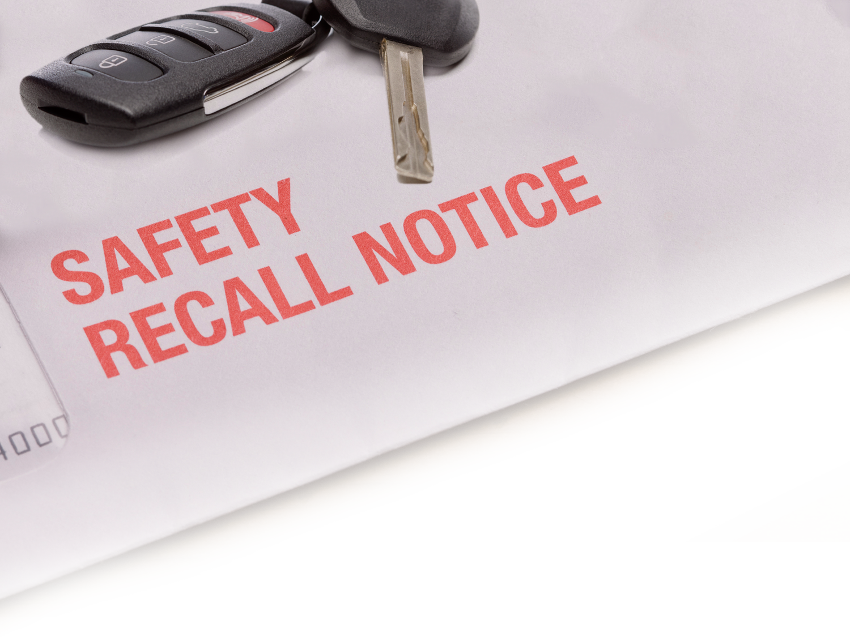
Recalls Update

Slide 3
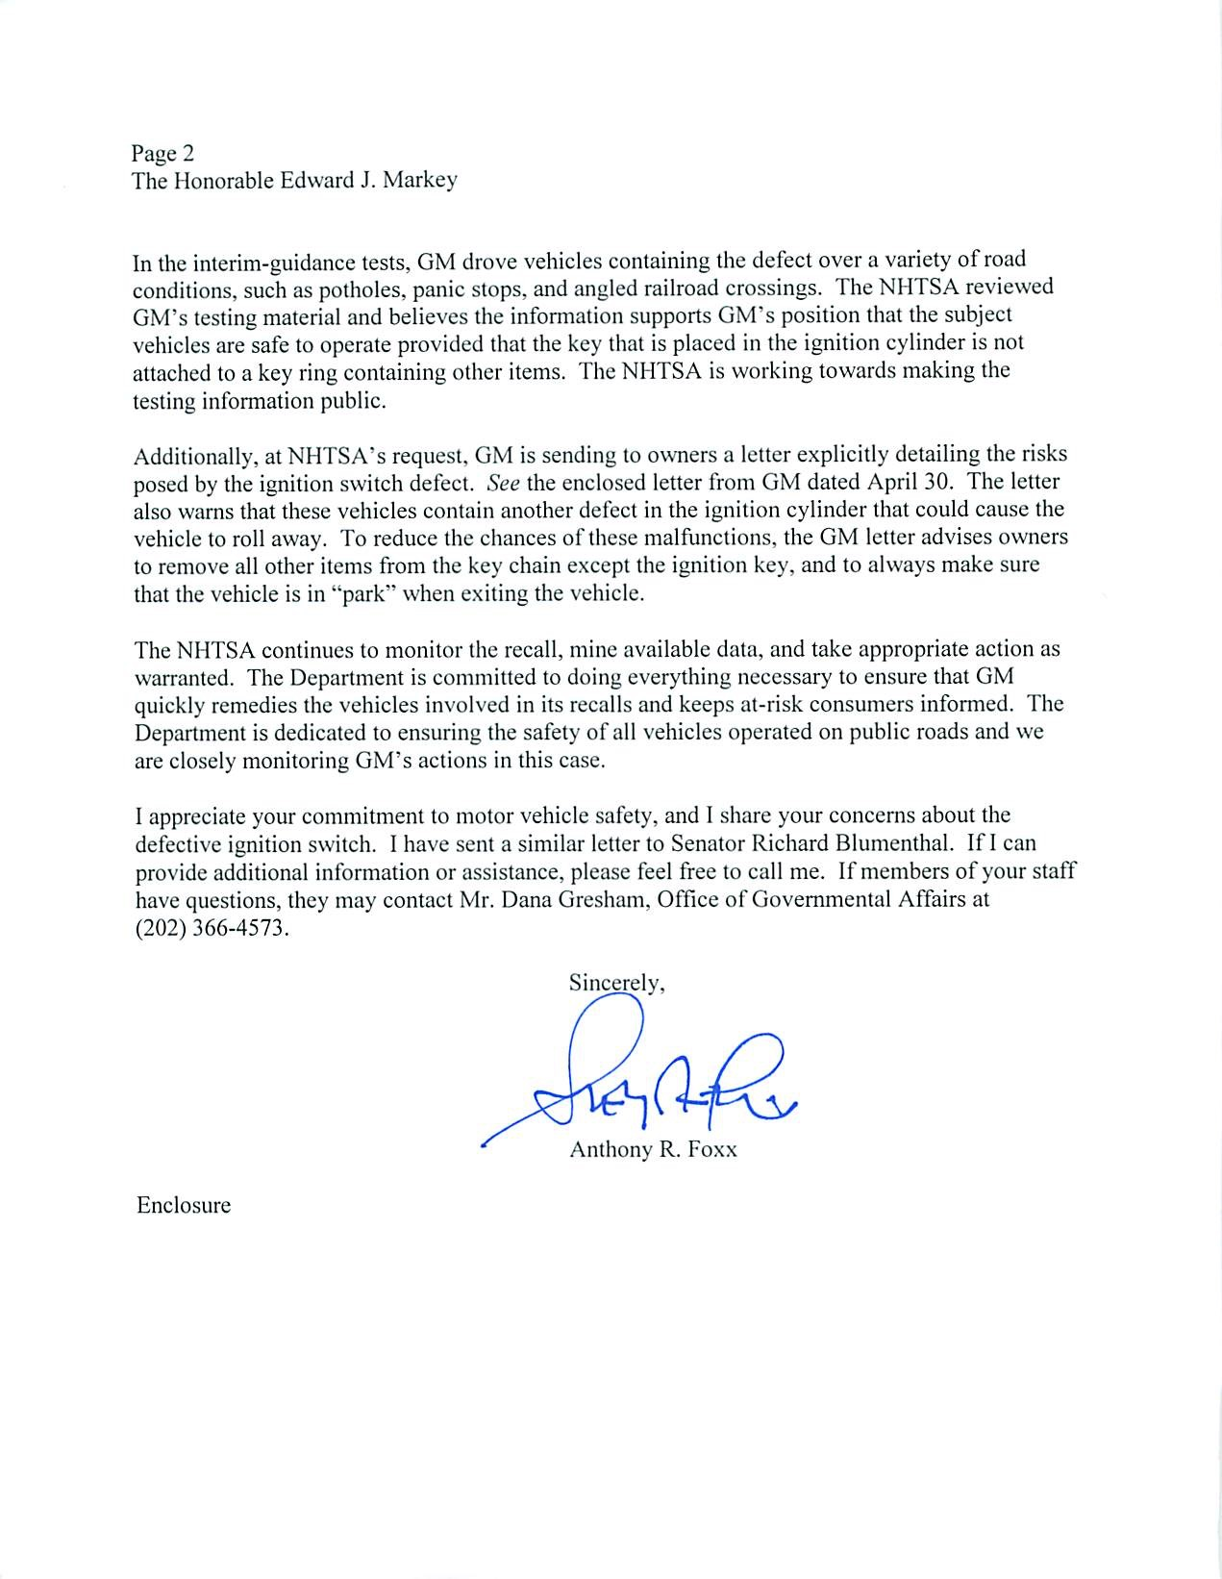
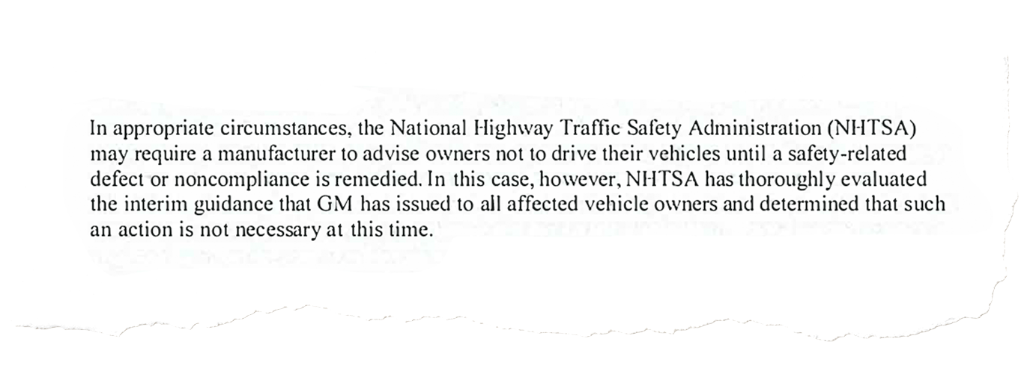

Slide 4
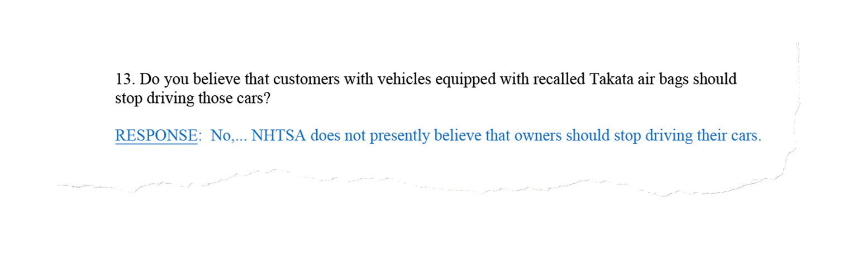

Slide 5
Recalls Update

Slide 7

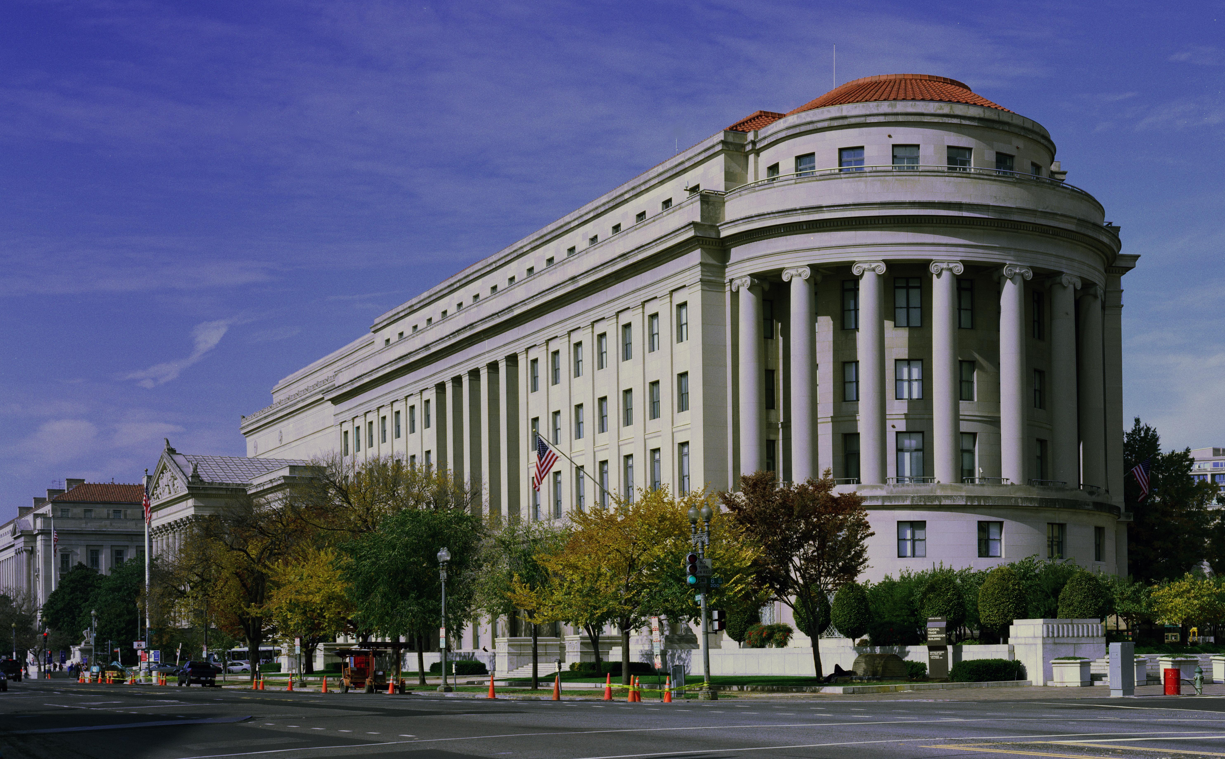
FTC Advertising Enforcement/Recalls

Slide 8

What It Involved
Used vehicle ads,
involving safety inspection claim,
in which certain advertised vehicles were subject to open safety recall, and
this fact was not disclosed to consumer.

Slide 9
FTC’s Proposed Remedy
Ensure that advertised vehicles are NOT subject to open safety recall, or
Ensure the following –
  Include disclosure in used vehicle ads making a safety inspection claim stating –
    that vehicle may be subject to an open safety recall, and
    how consumers can determine the vehicle’s recall status (https://vinrcl.safercar.gov/vin/); and
    2) If dealer receives written notification from a manufacturer that a used vehicle is subject to an open safety recall, clearly and conspicuously provide that notice – or a document w/ the same info in substantially the same format – to the consumer prior to consummation of the sale.

